Slide 1
Efficient Implementation of edge-preserving Denoising Filters on GPUs
BY
Kushagra Indurkhya: CS19B1017
Yashwanth Vallabhu: CS19B1030
Guided By,
Dr. Debasish Mukherjee

Slide 2
Introduction
Image processing is a complex field used in a variety of applications, including denoising to enhance image quality.
Denoising algorithms, such as Gaussian and bilateral filters, have benefits and drawbacks, with bilateral filter being better at maintaining edges and details but at a higher computational cost.
We aim to speedup the effective but complex denoising algorithms using CUDA GPUs to be used in real time applications.

Slide 3
Problem Statement
Identify edge-preserving effective denoising algorithms, and their variations and design some tweaks in the algorithms which can be parallelized to efficiently provide edge-preserving denoising for real-time applications like medical imaging, video processing and computer vision.
Implement the algorithms efficiently using CUDA programming to harness the massively parallel power of modern GPUs
Ideate and implement the optimizations that can be done to GPU implementation for more efficient usage of the cores, and memory to reduce the latencies.
Compare the performance of the optimized algorithm against the traditional CPU implementations using sequential and parallel paradigms.
Notes:
Identify edge-preserving effective denoising algorithms, and their variations and design some tweaks in the algorithms which can be parallelized and efficiently provide edge-preserving denoising.
Implement the algorithms efficiently using CUDA programming to harness the massively parallel power of modern GPUs

Slide 4
What is Noise?
Noise is defined as a random or patterned variation or disturbance in the image signal caused by a number of factors, including poor lighting conditions, long exposure times, and heat.
Image noise is a random variation of brightness or colour information in images, and is usually an aspect of electronic noise.

Slide 5
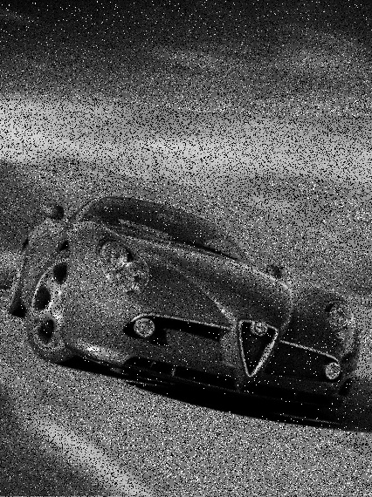
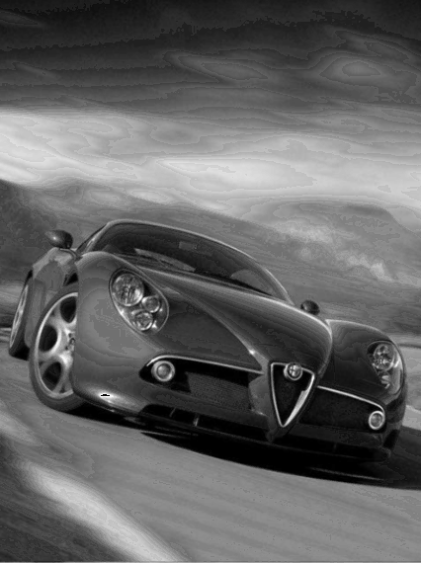
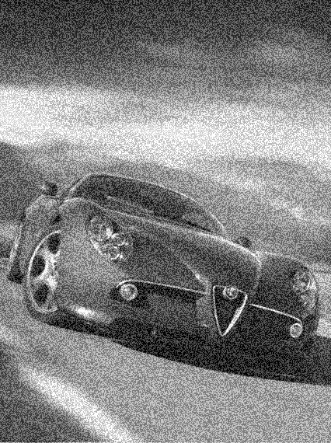
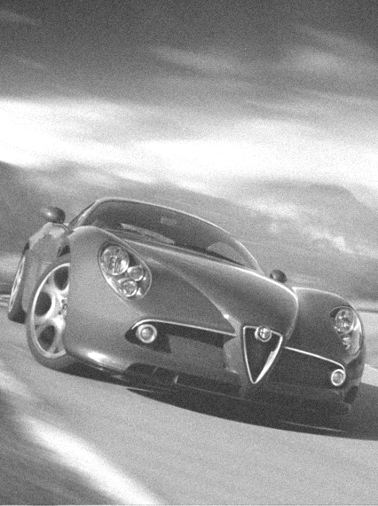

Types of Noise

Slide 6
Features of a good denoising system
Noise reduction
Preserve Image Features
Speed

Slide 7
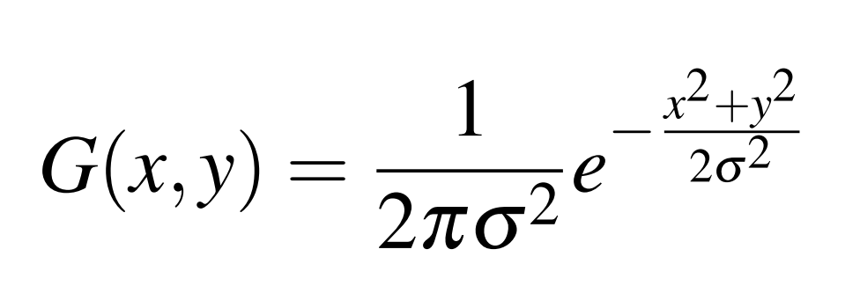
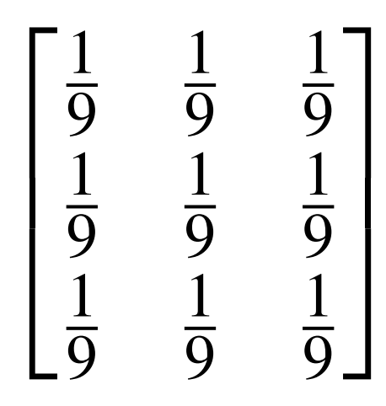
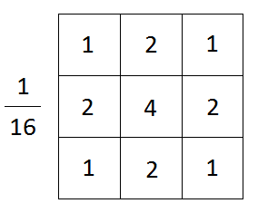
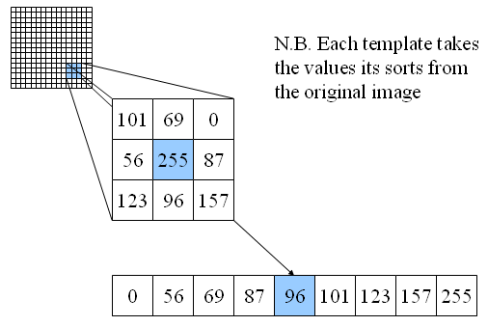
Traditional Denoising Methods
Box Filter
Median Filter
Gaussian Filter
where (x, y) are the coordinates of the kernel center, and σ is the standard deviation of the Gaussian distribution
Example: 3 x 3 Kernel

Slide 8
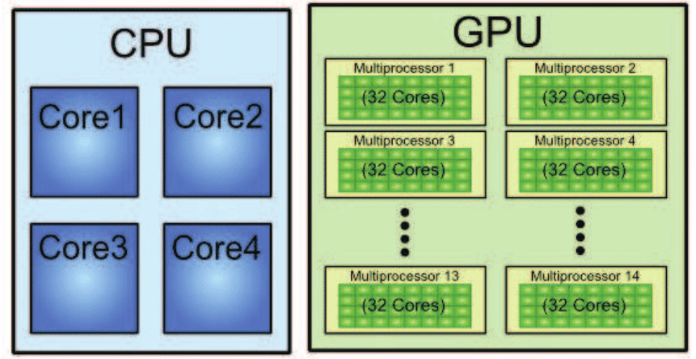
Leveraging the Power of GPU
https://www.researchgate.net/figure/Typical-CPUs-architecture-vs-a-typical-GPUs-architecture-source_fig3_319468789

Slide 9
Parallelization on GPU
GPUs have high memory throughput and make use of numerous lightweight computing cores to benefit from data parallelism. A single GPU device consists of various processing clusters, each having their dedicated cache layers and cores associated with them
GPUs have thousands of cores, which make them suitable for designing parallel computation-intensive applications. Each multiprocessor on a GPU uses a unique architecture called SIMT (Single Instruction, Multiple Thread)

Slide 10
Using CUDA for GPU Parallelization
CUDA is a general-purpose parallel computing platform developed by Nvidia to use on their GPUs, which allows software to perform general-purpose computations on GPUs
CUDA comes with various environments which allow developers to use it with different high-level languages such as C, C++, Java, Python, and Fortran. It is a scalable programming model, allowing software to scale its parallelization to the number of GPUs available, making the software adaptable to change in processing cores

Slide 11
Why is parallel processing important in image denoising?
It helps in reducing the overall processing time.
Saves time and costs by efficiently utilizing resources.
It provides real-time experiences for users and improves their overall experience.
It plays a crucial role in industries such as medicine, where it helps generate faster and more accurate diagnoses, and in the space industry, where it is used for simulating and designing optimal trajectories.
Notes:
Image denoising involves processing large amounts of data, which can be time-consuming with sequential processing.

Slide 12
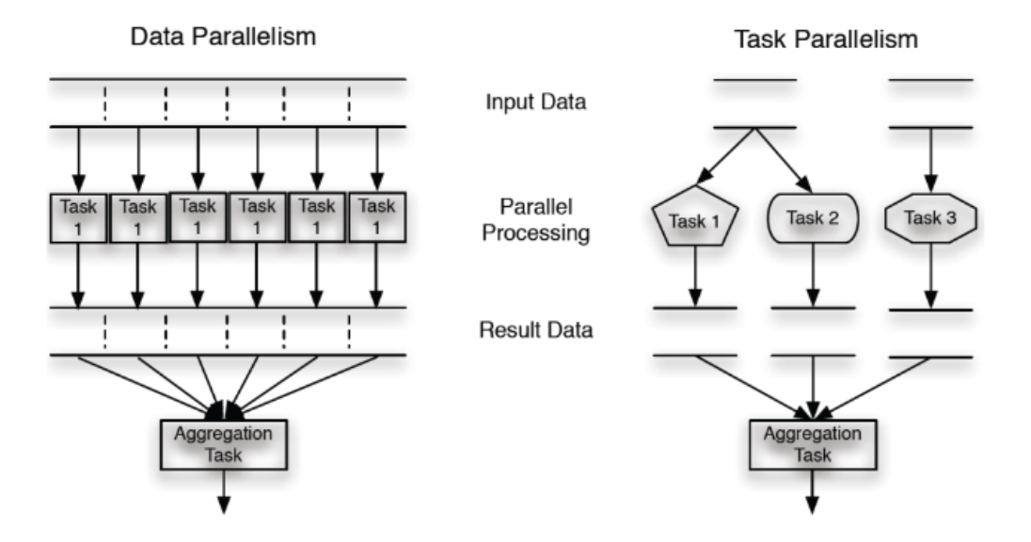
Types of Parallelization
Task Parallelism:
Ex: Software testing, independent tests executed concurrently
Data Parallelism:
Ex: Image or video processing, repetitive computations on large data
Challenges: Race conditions, Deadlock, Load balancing, Synchronization across threads

Slide 13
Algorithm 1:
Bilateral Filter

Slide 14
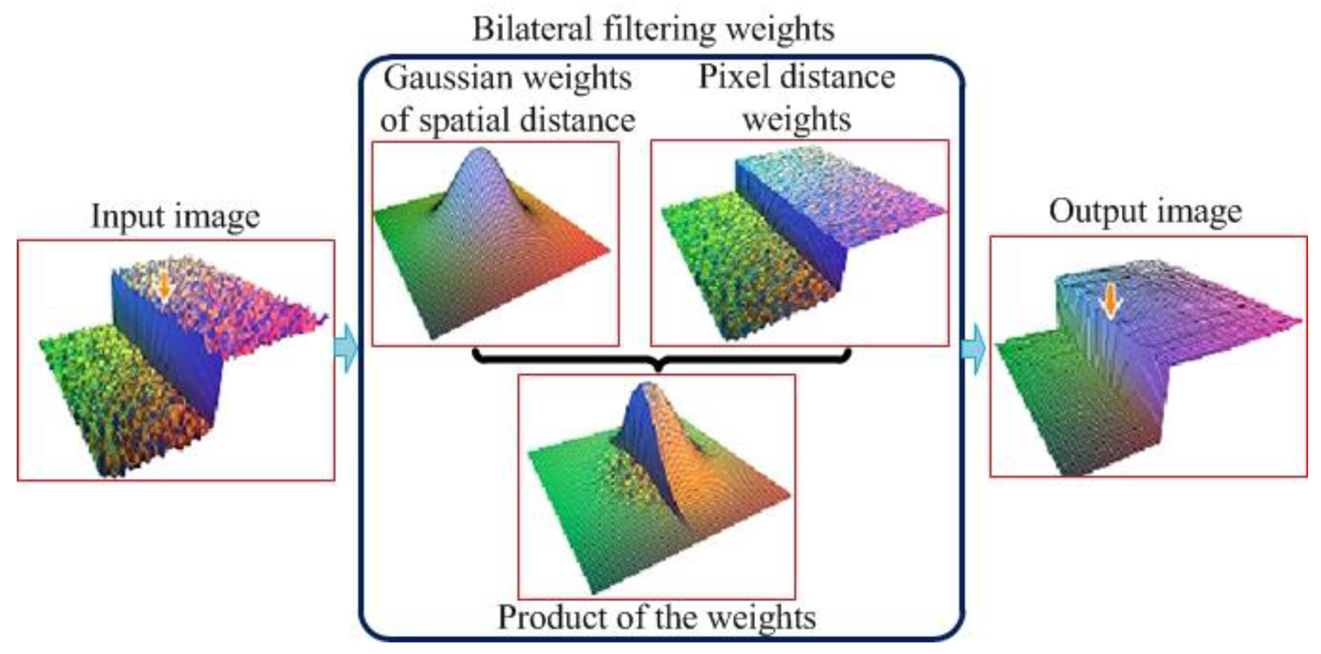
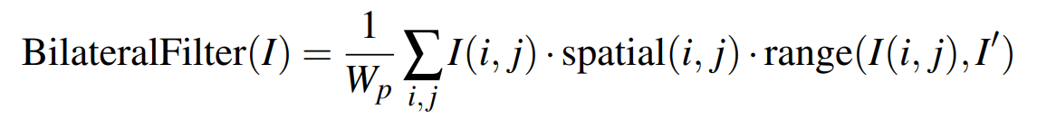
Bilateral Filter
Source: http://doi.acm.org/10.1145/566570.566574
Notes:
The bilateral filter smooths an input image while preserving its edges. Each pixel is replaced by a weighted average of its neighbours. Each neighbour is weighted by a spatial component that penalizes distant pixels and range component that penalizes pixels with a different intensity. The combination of both components ensures that only nearby similar pixels contribute to the final result.

Slide 15
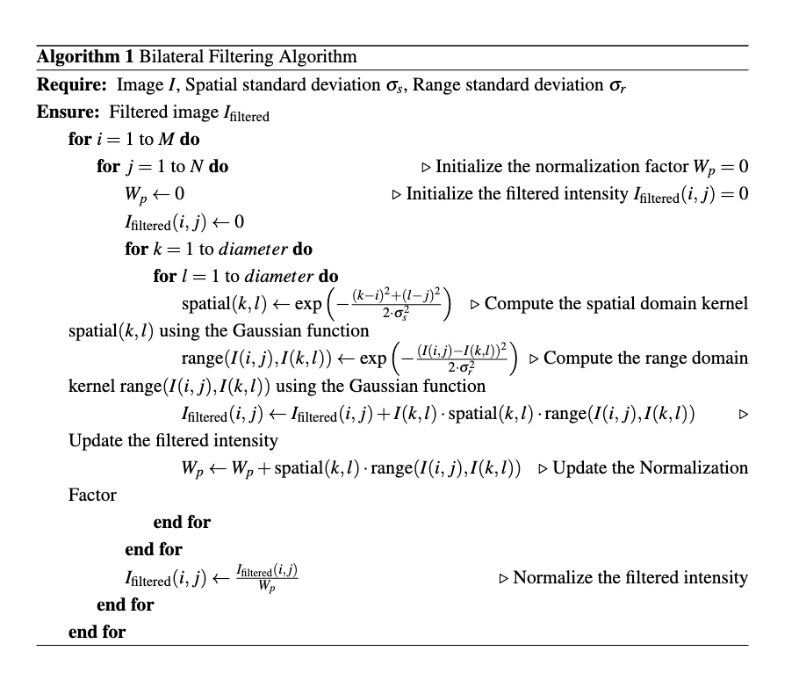

Slide 16
Algorithm 2:
Adaptive Bilateral Filter

Slide 17
Idea:
The adaptive bilateral filter typically provides control over various parameters, such as the local characteristics used for adaptivity, the strength of the adaptivity, and the size of the local neighborhood. This allows users to fine-tune the filter’s behavior based on their specific needs and requirements, the key ideas this improved bilateral algorithm works on are the following:
Adaptivity
Localization properties
Notes:
Low Variance:The filter only considers a narrow range of pixel values as similar, resulting in oversmoothing and loss of details. As we can see, the image looks blurry, and the edges are not well defined.
High Variance : the filter becomes less selective about which pixel values are considered similar, which can result in under-smoothing and the introduction of unwanted noise. As we can see, the image is no longer oversmoothed, but there are now some artifacts and noise in the image.
Adaptivity:

Slide 18
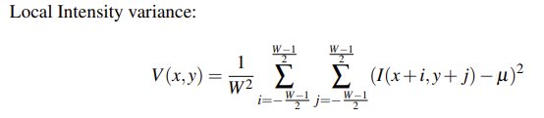
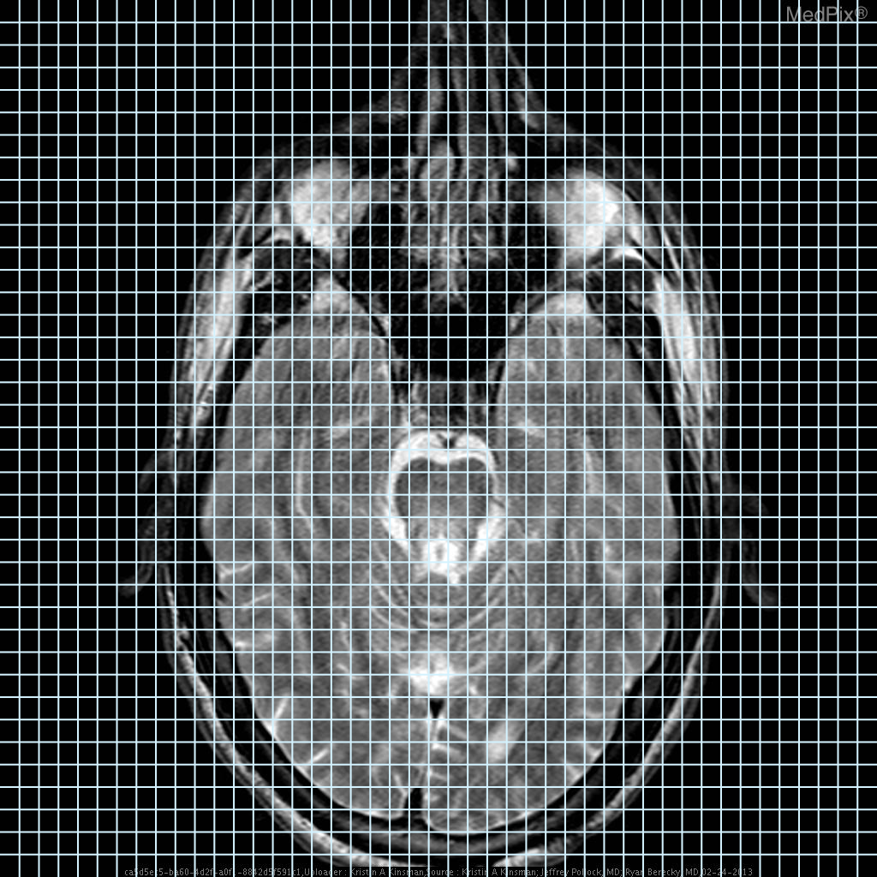
Apply one iteration of bilateral filter
Calculate variance
Calculate new range sigma
For this window (Regularized)
Apply the bilateral filter with new range sigma

Slide 19
Proposed Work in respect to the algorithm
Intensity Variance as adaptivity parameter
Intensity variation indicator
Sensitivity to local changes
Robustness to noise
Easy to compute
Notes:
using variance as a metric, an adaptive bilateral filter can effectively capture the local characteristics of the image content, such as edges, textures, and details, which often exhibit higher intensity variations
Variance is sensitive to local changes in the image content. When there are intensity transitions or changes within a neighborhood, the variance value increases, indicating a change in the local image characteristics. This sensitivity to local changes makes variance a suitable metric for localization in adaptive bilateral filters, as it can capture the presence of edges, textures, or other local features that require localized filtering
Robustness to noise : Variance is relatively robust to noise compared to other metrics,such as gradient magnitude or image structure, which can be affected by noise. Since variance is based on the squared differences between intensity values and the mean intensity, it tends to amplify larger differences while reducing the impact of small differences due to noise. This makes variance a robust metric for localization in adaptive bilateral filters, as it can effectively capture the local intensity variation even in the presence of noise

Slide 20
Applying basic bilateral filter to a neighborhood before calculating its variance,
Noise reduction
Edge preservation
Computational efficiency
Regularization
Notes:
Another change that we made in our adaptive bilateral filter ,instead of directly calculating the variance of the intensities, this was done because for the following reasons:

Slide 21
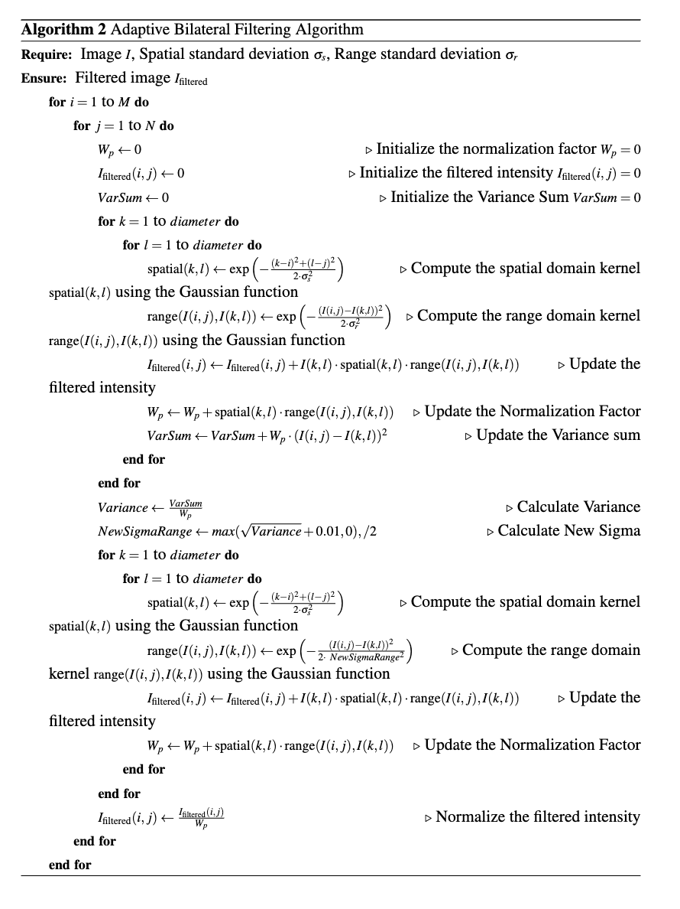

Slide 22
Algorithm 3:
Non Local Means + Bilateral Filter

Slide 23
Idea:
The Non-Local Means bilateral filter improves upon the traditional bilateral filter by considering patch-based similarity, allowing for non-local information exchange, providing flexibility in tuning parameters and being versatile for different image processing tasks.

Slide 24
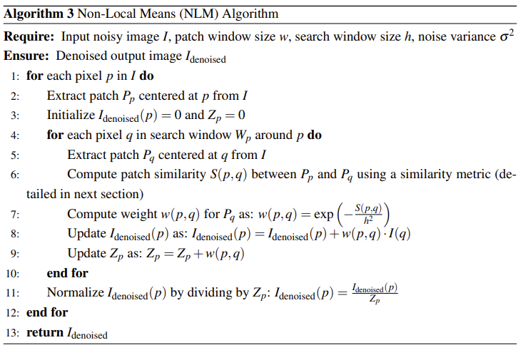
Non-Local means algorithm:
Non-local means (NLM) is an image-denoising algorithm that aims to remove noise from an image while preserving its details.
The NLM algorithm consists of the following steps:
Patch extraction
Patch similarity calculation
Weight calculation
Denoised pixel calculation

Slide 25
NL-means + Bilateral filter:
The Non-Local Means (NLM) + Bilateral Filter algorithm is a hybrid denoising algorithm that combines the strengths of both the NLM and bilateral filter approaches to achieve improved image denoising performance.
NLM part of the algorithm is responsible for capturing the non-local similarity information from the entire image in order to denoise each pixel.
The Bilateral Filter part of the algorithm is used to further refine the denoised image obtained from the NLM part.

Slide 28
Advantages over traditional bilateral filter:
Patch based similarity
Non-Local information exchange
Flexibility in tuning parameters
Versatility for different applications

Slide 29
Proposed Work in respect to the algorithm:
Keep the whole image as the search window.
Improved Denoising Performance
Better Preservation of Image Features
Robustness to Local Image Variations
Reduced Blocking Artifacts
Flexibility in Parameter Selection
Notes:
Improved Denoising Performance: Using a larger search window allows for a more extensive search space, which can result in better denoising performance. It enables the filter to consider a wider range of pixels in the image when calculating the weighted average, leading to a more effective removal of noise while preserving image details. – Better Preservation of Image Features: A larger search window in bilateral filter- ing allows for better preservation of image features, as it considers a larger neigh- borhood around each pixel. This can help in retaining sharp edges, fine textures, and other important image details that may be lost with a smaller search window. – Robustness to Local Image Variations: In images with local variations in inten- sity or color, using a larger search window can help in capturing the local image characteristics more effectively. This can lead to improved filtering results, as the filter can adapt to varying local image structures and textures. – Reduced Blocking Artifacts: Bilateral filtering can sometimes introduce blocking artifacts, which are visible as sharp transitions between filtered and non-filtered regions. Using a larger search window can help in reducing such artifacts, as it allows for a smoother transition between filtered and non-filtered regions, resulting in a more visually pleasing output. – Flexibility in Parameter Selection: With a larger search window, bilateral filtering can be less sensitive to the choice of parameters such as the filter kernel size or the intensity/color similarity threshold. This can provide more flexibility in parameter selection, making it easier to achieve desired filtering results across a wider range of images.

Slide 30
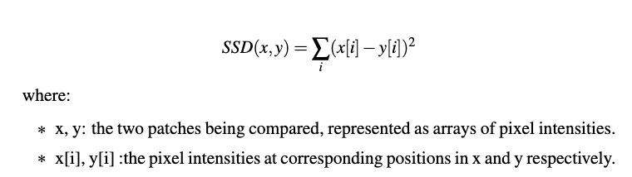
Use SSD as metric for patch similarity index.
Intensity-based Similarity
Easy to Compute
Sensitivity to Pixel Differences
Widely Used in Literature
Notes:
2)
SSD has been widely used in various image processing and computer vision applications, including non-local means bilateral filtering. It has been extensively studied in the literature and has shown promising results in many practical scenarios
3)

Slide 31
Use intensity difference Gaussian in weight.
Improved Filtering Accuracy
Robustness to Local Image Variations
Enhanced Preservation of Image Details
Flexibility in Parameter Selection
Improved Performance on Images with Large Intensity Variations.

Slide 32
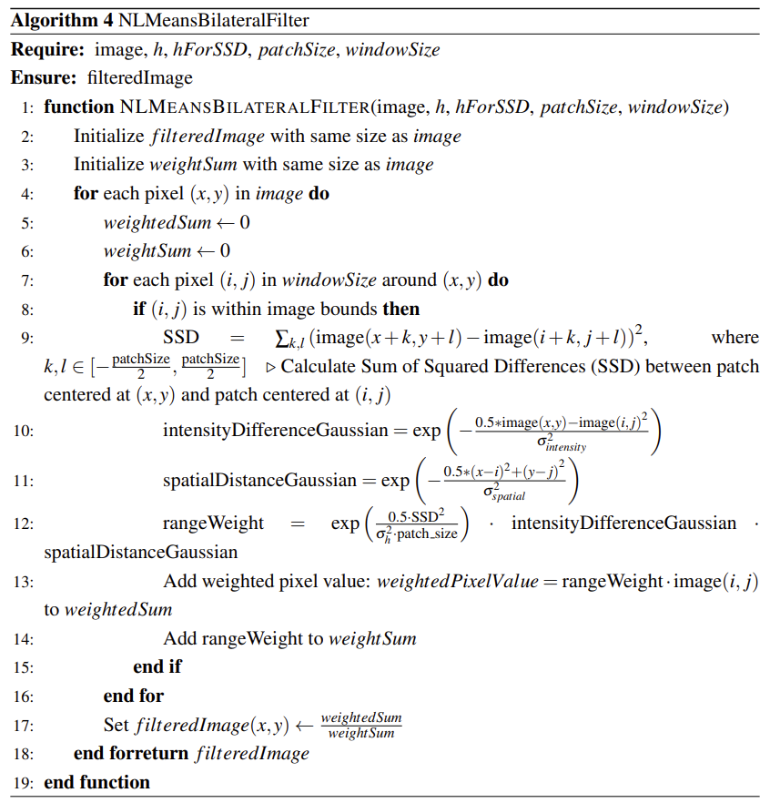

Slide 33
Literature Review
Ref no | Approach | Results
[1] | Explore the performance impact of using different memory access patterns, of using different types of device/on-chip memories, of using strictly aligned and unaligned memory, and of varying the size/shape of thread blocks to achieve optimal performance on GPUs | They achieved a 200x speedup compared to a single-threaded CPU implementation
[2] | Authors have showed that advanced acceleration techniques (such as pre-computation, prefetching) for gaussian spatial kernel can further speedup straightforward GPU implementations of bilateral filter and nearest neighbourhood filter. | They achieved a speedup of 1.4 with respect to naive GPU Implementation
[3] | Authors tried implementing Non-local means on a GPU. The GPU-based NLM denoising algorithm does not change the accuracy of the original algorithm, that is, effectively maintains the image edges and small structures, at the same time removes the noises. | They achieved a 45x speedup.

Slide 34
GPU Optimizations

Slide 35
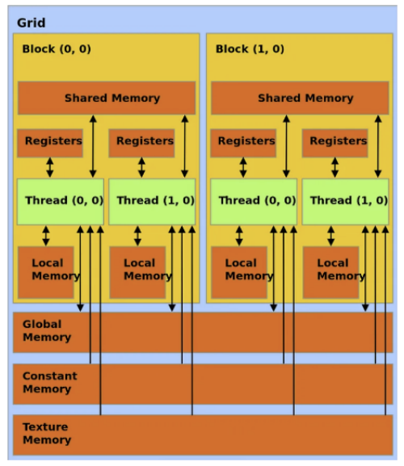
Memory Hierarchies:
Global memory
Shared memory
Constant memory

Slide 36
Tiling source image in shared memory
We loaded the image data into shared memory which is done by each thread block, which is portion of the image that will be processed together by the threads in that block.
The image data is loaded into shared memory in a tiled fashion.
Each thread add its pixel to the shared memory, which can be used by other threads in the block.
The request of values from global memory is done in a coalesced manner by consecutive access by the same warp/half warp.
Border Pixels are handled by a bunch of conditional statements
Notes:
with each thread block loading a subset of the image into its shared memory allowing for faster access to the image data during computation, since the data is stored in the fast on-chip memory of the GPU.

Slide 37
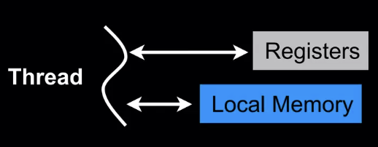
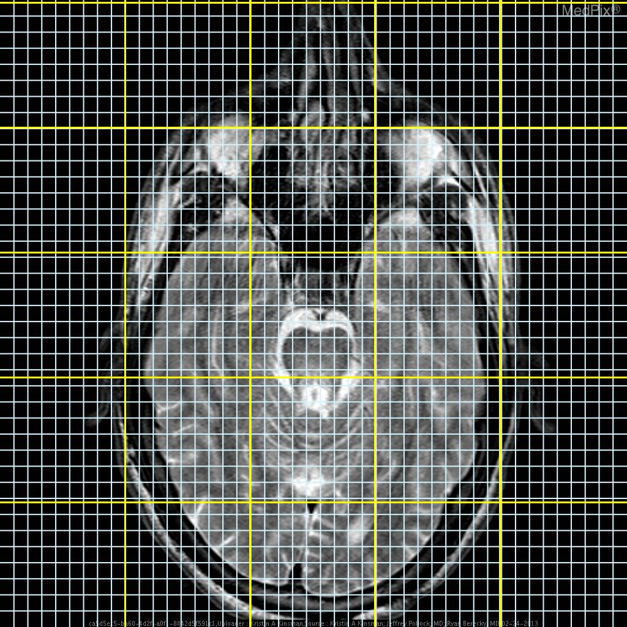
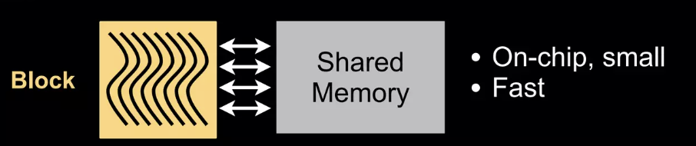
Handle Padding
Insert Pixel in SM

Slide 38
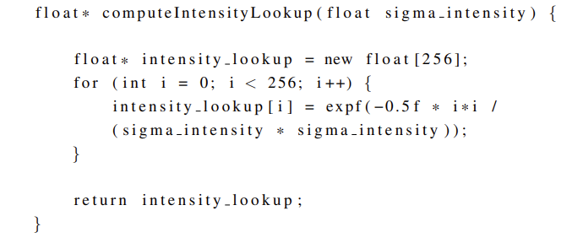
Precomputing Gaussian intensity kernel:
Instead of computing gaussian intensity kernel on every iteration for every thread (which makes redundant computations), we have computed the kernel once at the beginning and passed it to all the threads.

Slide 39
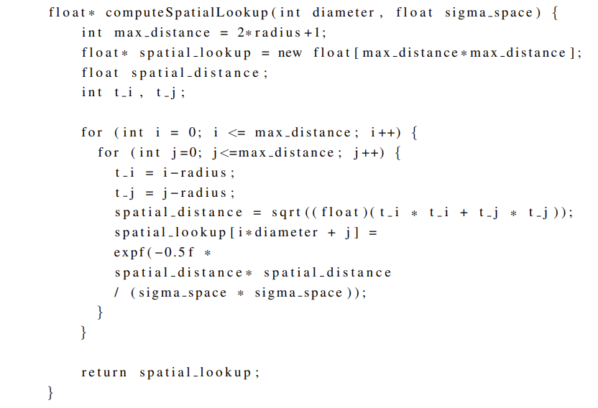
Precomputing Gaussian spatial kernel:
Instead of computing gaussian spatial kernel on every iteration for every thread (which makes redundant computations), we have computed the kernel once at the beginning and passed it to all the threads.

Slide 40
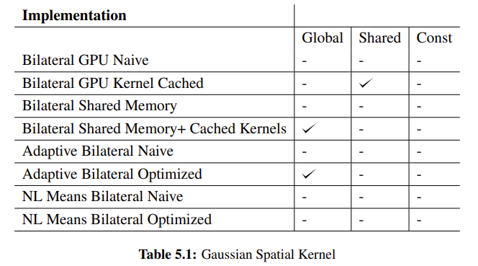
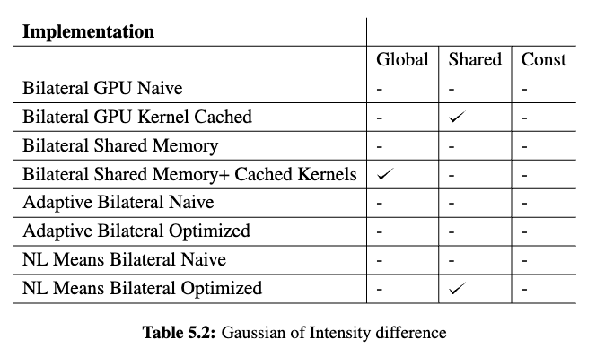
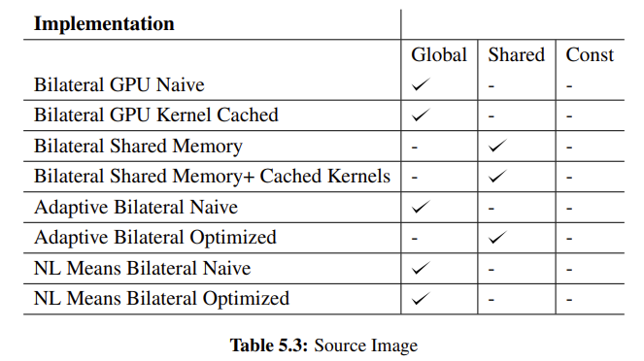
Summary of all the implementations:

Slide 41
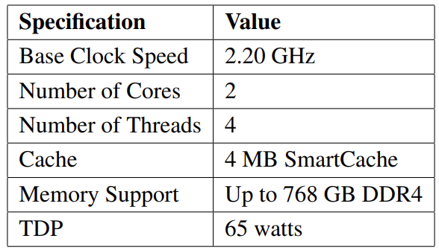
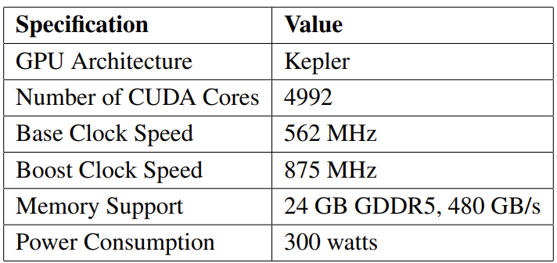
Experiment Setup
For executing sequential and parallel implementations, we have used the CPUs provided by Google Colab : Intel(R) Xeon(R) CPU @ 2.20GHz. It consists of 2 cores.
For executing the GPU implementations, we used the GPUs provided by Google Colab, which is the Nvidia Tesla K80 GPU. It consists of 4992 CUDA Cores.

Slide 42
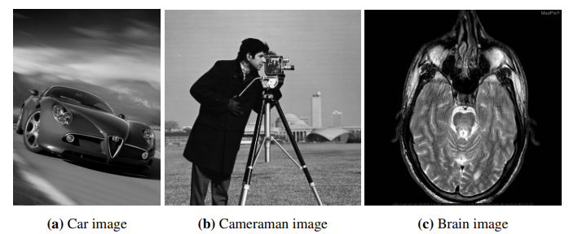
Images used:

Slide 43
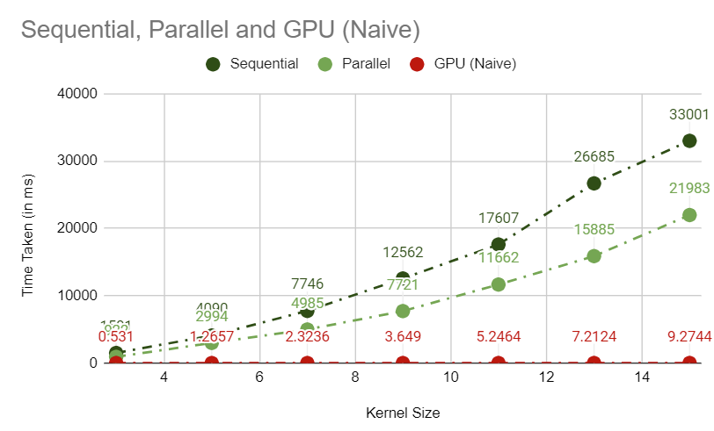
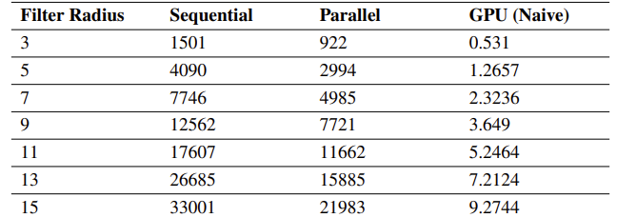
Results: Experiment-1
In this experiment, we have varied the size of the filter and observed the time taken by CPU implementations and GPU Naive implementation.
Speedup achieved is 3558.28

Slide 44
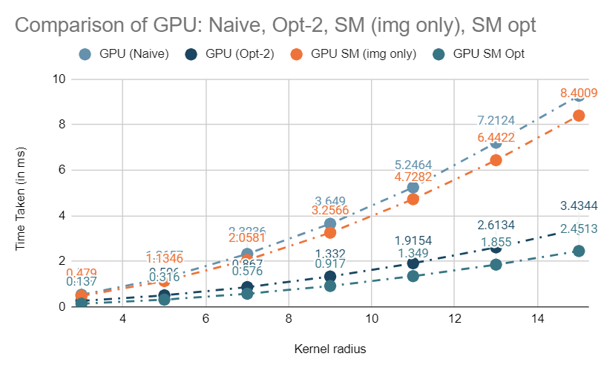
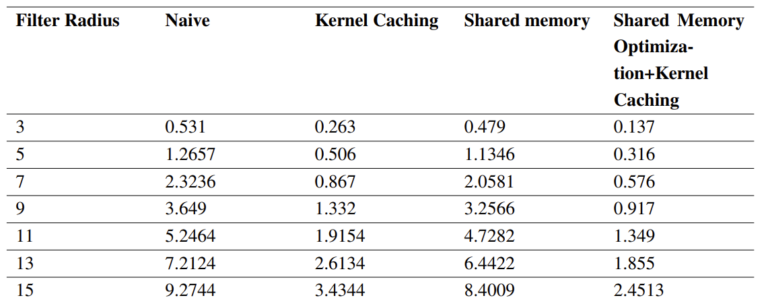
Experiment-2
In this experiment, we have varied the size of the filter and observed the time taken by different GPU implementations.

Slide 45
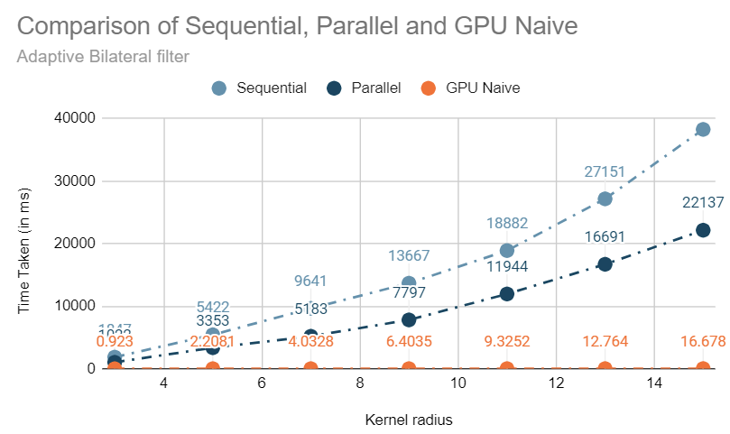
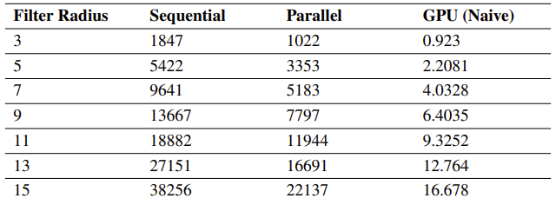
Experiment-3
In this experiment, we have observed the time taken by CPU and GPU implementations of Adaptive bilateral filter with varying kernel size.
Speedup achieved is 2293.8

Slide 46
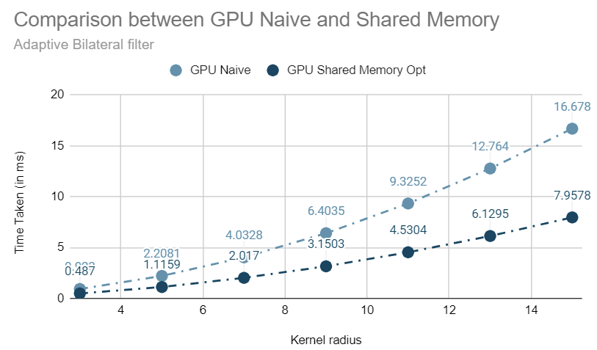
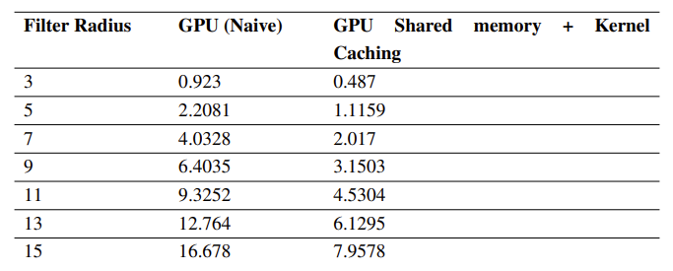
Experiment-4
In this experiment, we have varied the size of filter and observed the time taken by different GPU variations of Adaptive bilateral filter.
Speedup achieved by optimized method is 4807.35

Slide 47
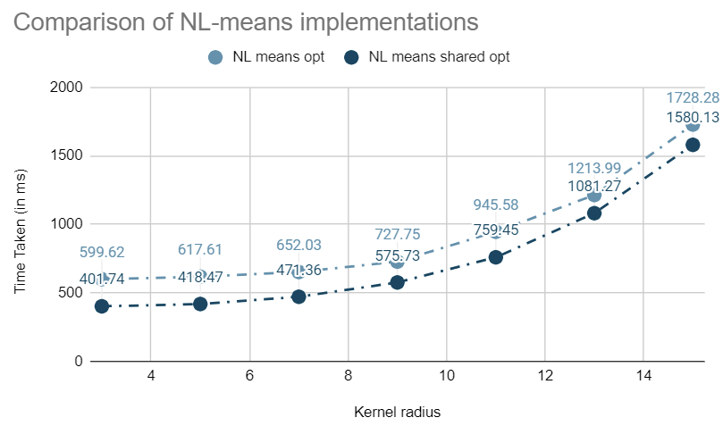
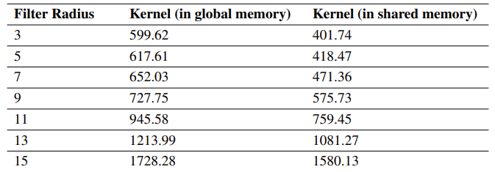
Experiment-5
In this experiment, we have compared the time taken by different GPU variations of NL-means bilateral filter.

Slide 48
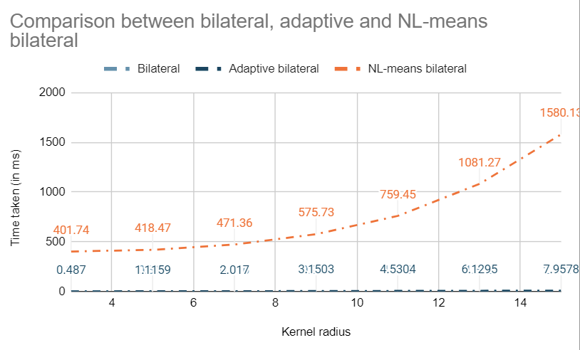
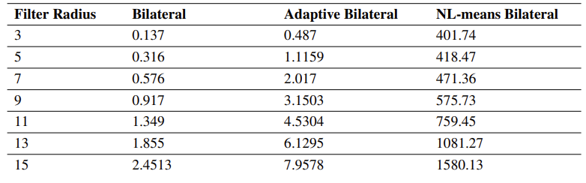
Experiment-6
In this experiment, we have varied the filter size and observed the time taken by bilateral, adaptive and NL-means bilateral filter.

Slide 49
PSNR Comparisions
Filter Radius | Bilateral | Adaptive Bilateral | NL means + Bilateral
3 | 27.419 | 27.466 | 27.551
5 | 27.456 | 27.478 | 27.550
7 | 27.504 | 27.506 | 27.552
9 | 27.530 | 27.527 | 27.536
11 | 27.530 | 27.541 | 27.550
13 | 27.536 | 27.548 | 27.551
15 | 27.549 | 27.561 | 27.573

Slide 50
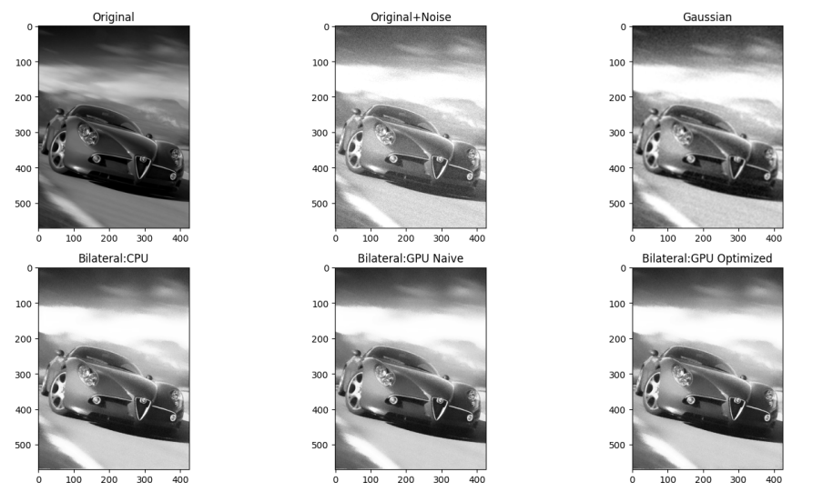
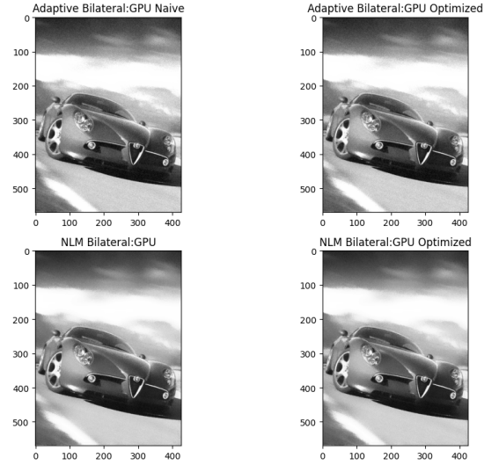
Visual Quality Analysis:
Car Image

Slide 51
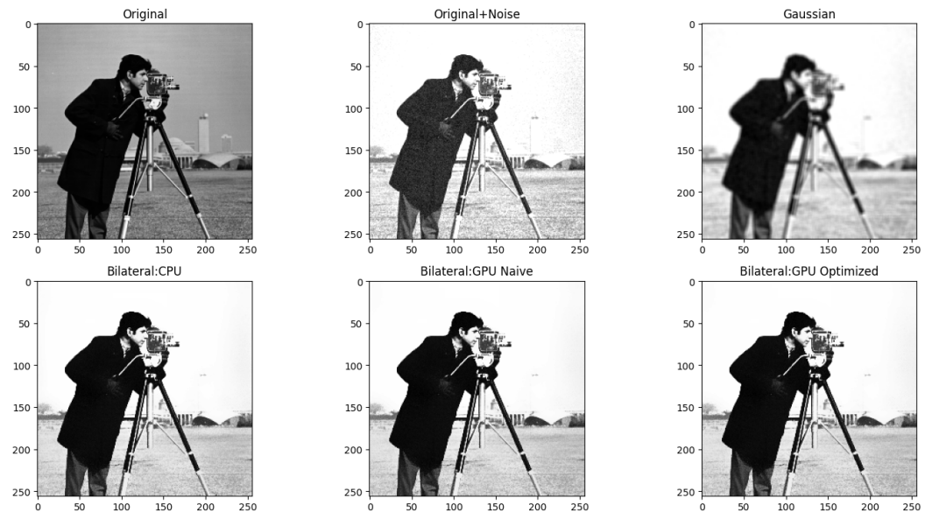
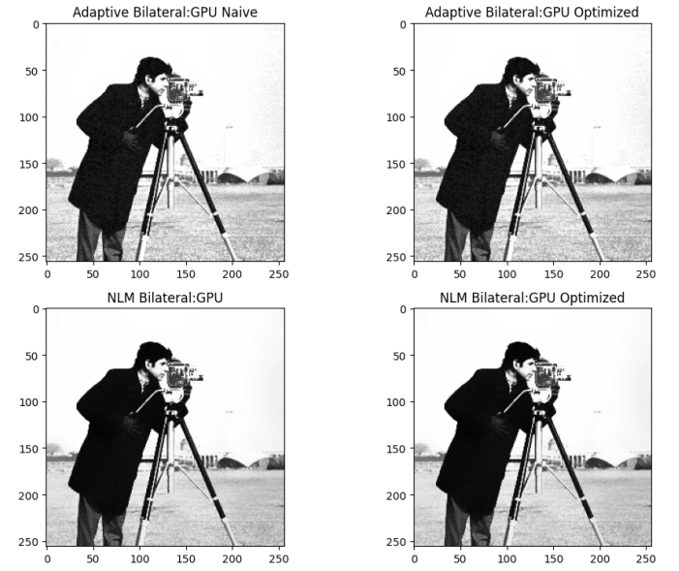
Cameraman image:

Slide 52
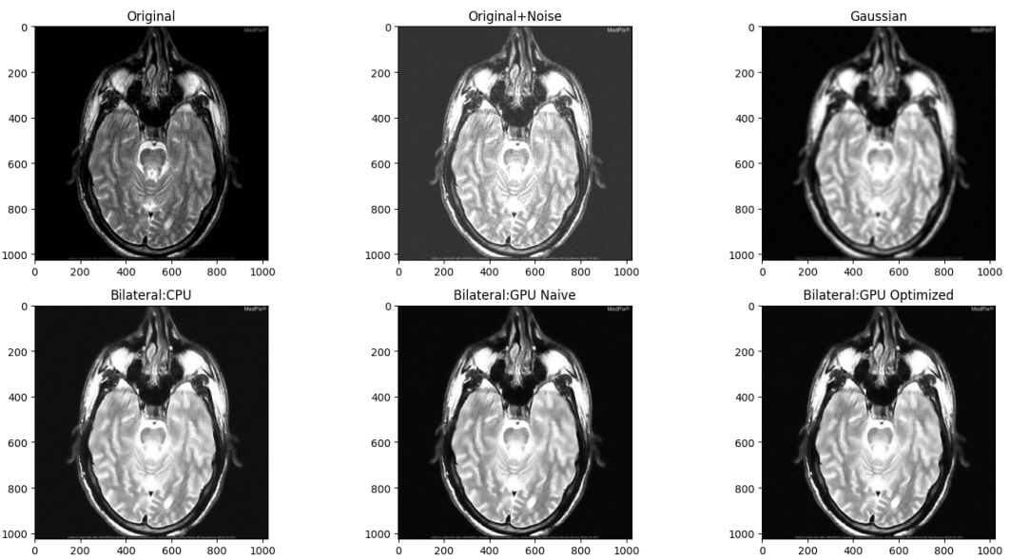
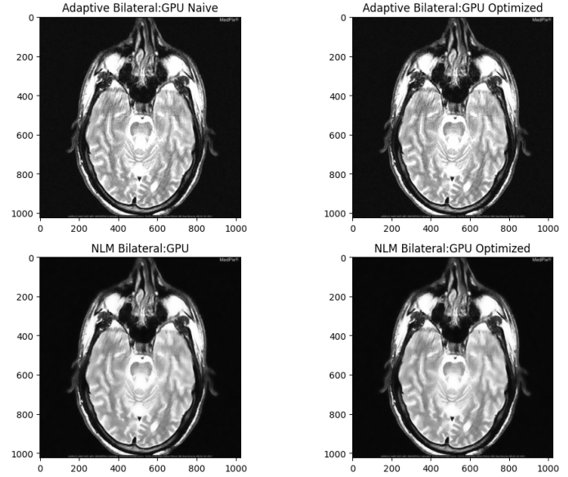
Brain image:

Slide 53
Demonstration

Slide 54
Conclusion
This project focuses on parallelization of image processing on GPU so as to reduce its execution time so that it can be useful in real-time applications like medical imaging, video processing.
As the results suggest, the time taken by GPU implementations is significantly faster than Sequential and CPU parallel implementations.
The speedup achieved by the naive GPU is approximately 3696.75 times when compared to sequential CPU.
The speedup achieved by the optimized GPU is approximately 13462.65 times when compared to sequential CPU.
Optimized version gives a speedup of 3.78 compared to the Naive implementation, while the previous works in [2] gives 1.4 speedup.

Slide 55
Challenges faced
Lack of standard frameworks which provide real life simulation of noises in medical images.
Lack of many open access research papers and literature around the GPU implementations of the algorithms.
Lack of Long running dedicated GPUs, Colab GPUs come with ephemeral storage which meant compiling binaries after every session and there are limits imposed on the usage duration of GPUs as well.

Slide 56
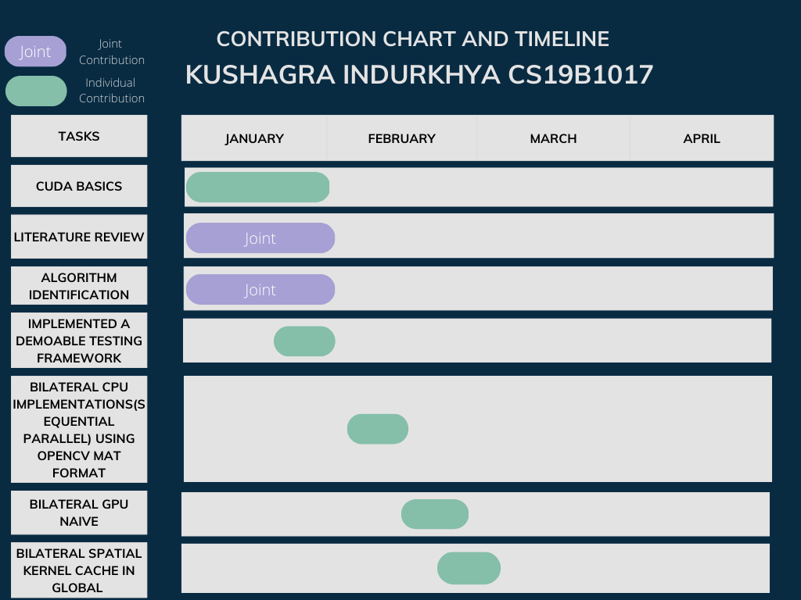

Contributions: Kushagra Indurkhya

Slide 57


Contributions: Yashwanth Vallabhu

Slide 58
References
E. Bethel. Exploration of optimization options for increasing performance of a GPU implementation of a three-dimensional bilateral filter. Technical report, Lawrence Berkeley National Laboratory, 2012.
Ziyi Zheng, Wei Xu, and Klaus Mueller. Performance tuning for CUDA-accelerated neighbourhood denoising filters. 01 2011
Kuidong Huang, Dinghua Zhang, and Kai Wang. Non-local means denoising algorithm accelerated by GPU. In Faxiong Zhang and Faxiong Zhang, editors, MIPPR 2009: Medical Imaging, Parallel Processing of Images, and Optimization Techniques, volume 7497, page 749711. International Society for Optics and Photonics, SPIE, 2009.

Slide 59
Questions

